Slide 1
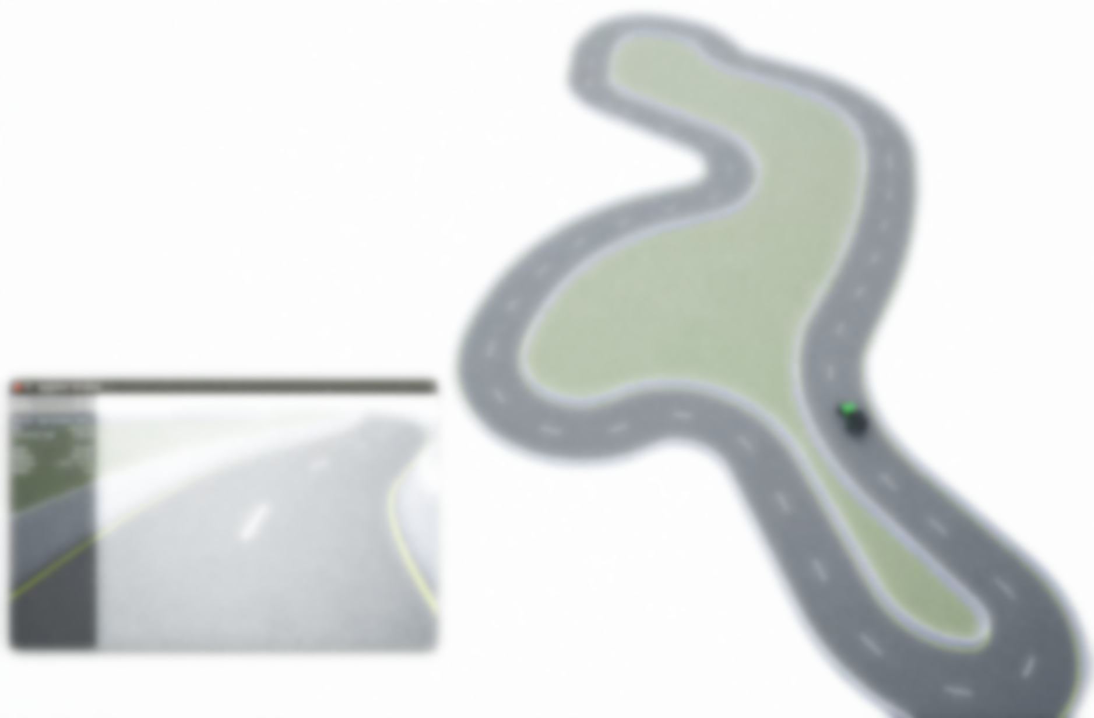
MoCAD: Carla-python Experimental Course
Ⅳ Behavior cloning (BC)
Notes:
为什么要采用BC呢？和PID控制的不同之处？RL 呢？

Slide 2
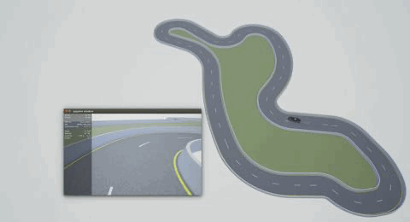
Outline
Imitation learning—Behavior Cloning
Collecting data: Autopilot or manual control
Training Model: Supervise learning
Applying the model to control vehicle
Notes:
实现BC控制的几个步骤

Slide 3
1. Imitation learning—Behavior Cloning
Imitation learning and why ?
An expert (typically a human) provides us with a set of demonstrations.
The agent then tries to learn the optimal policy by following, imitating the expert’s decisions.
Reinforcement learning (RL) reward sparse or hard to design
IL interacts with the environment
Markov Decision Process (MDP)
an A set of actions
an S set of states
a P(s’|s,a) transition
an unknown R(s,a) reward function
The expert’s demonstrations τ = (s0, a0, s1, a1, …), actions are based on the expert’s (“optimal”) π* policy
Notes:
https://medium.com/@SmartLabAI/a-brief-overview-of-imitation-learning-8a8a75c44a9c

Slide 4
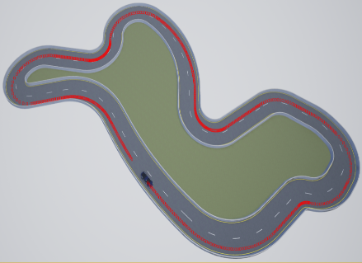
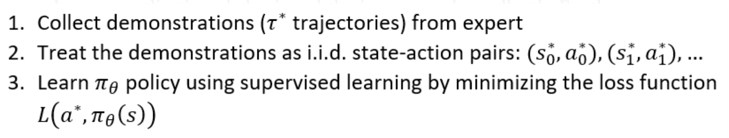
1. Imitation learning—Behavior Cloning
Imitation learning classification
Carla Simulator
Behavior Cloning
Direct Policy Learning
Inverse Reinforcement Learning
Collecting data
(image – action)
Loading model
Training model
(Regression Problem)
Behavior Cloning
learning the expert’s policy using supervised learning.
End to end learning
Notes:
BC最大的问题是累计误差：
原因：iid → MDP
in MDP an action in a given state induces the next state, which breaks the previous assumption. This also means, that errors made in different states add up, therefore a mistake made by the agent can easily put it into a state that the expert has never visited and the agent has never trained on.
把BC运行的过程说清楚

Slide 5
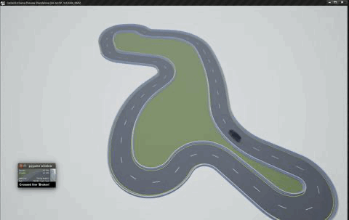
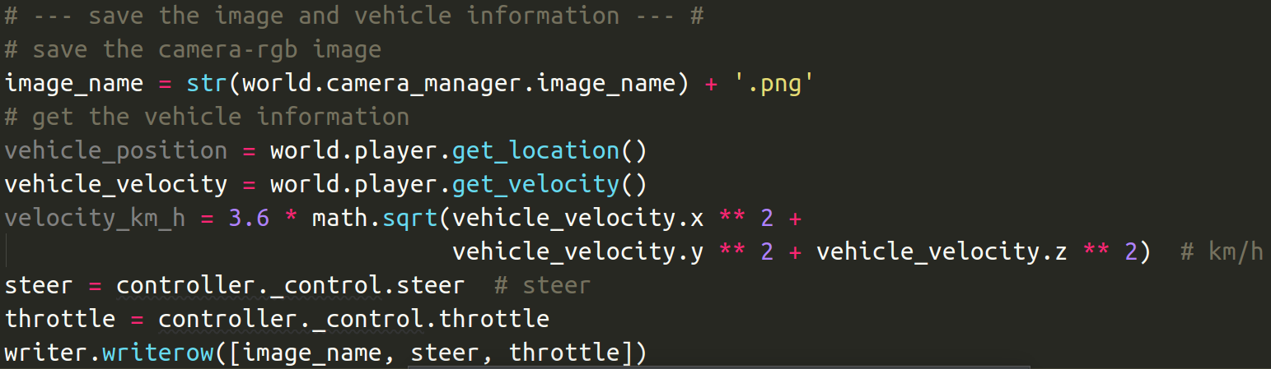
2. Collecting data: Autopilot or manual control
Carla Simulator
Mode: Synchronous or Asynchronous
Sensor: RGB-image，Depth-image，Lidar
Vehicle: Autopilot or manual control
Action：Steer，throttle，brake
Moving the vehicle and Collecting Data
Control method:
Autopilot → PID
Manual control → Keyboard
Data:
RGB-image & Vehicle States
Notes:
使用的Carla工作模式
Data：image—states 对

Slide 6
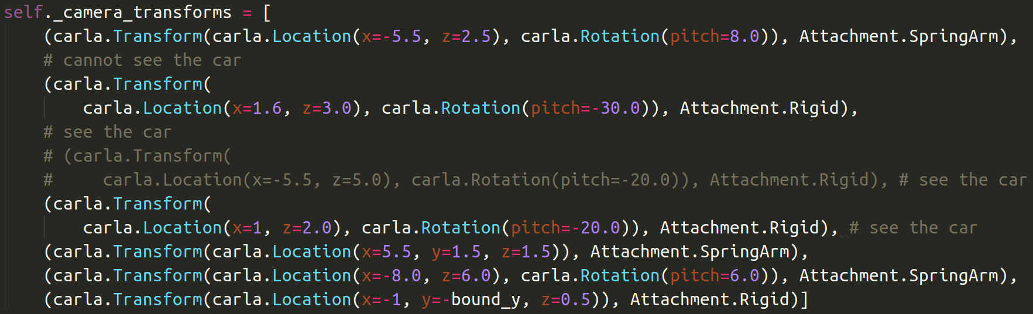
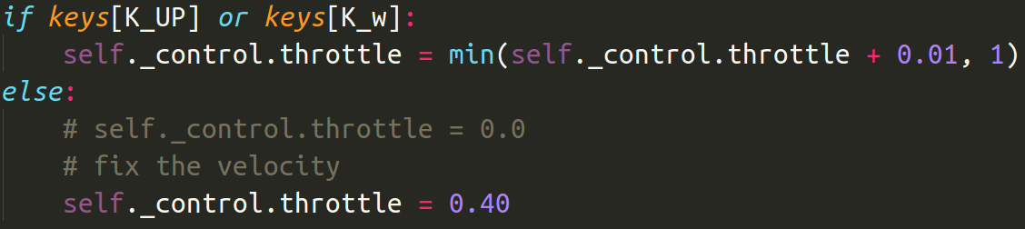
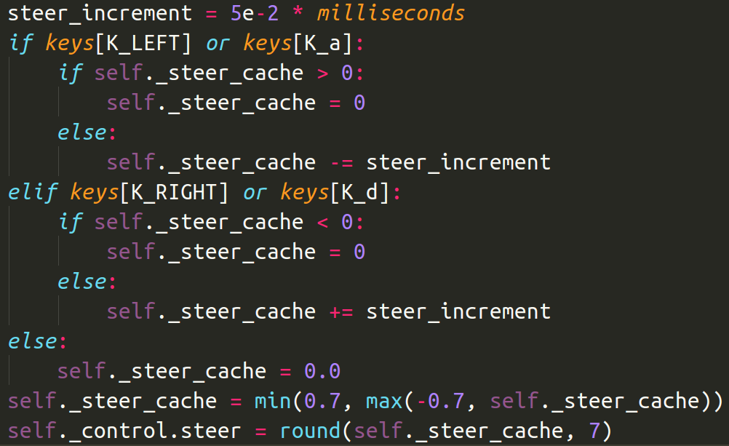
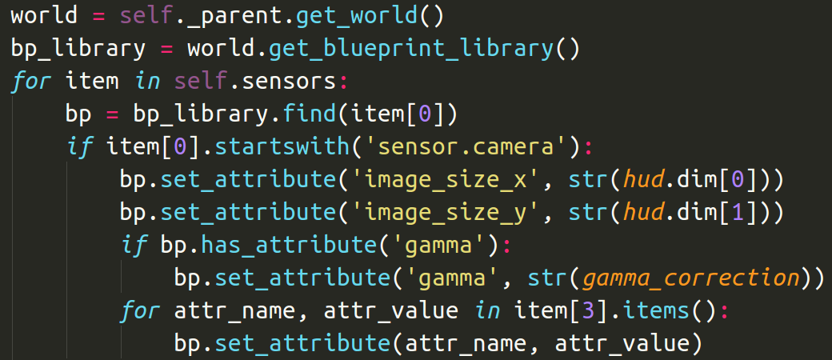
2. Collecting data: Autopilot or manual control
Data：image – action pair
RGB-image：position，rotation，size
Action： Fixed throttle，steer
Notes:
传感器的位置摆放很重要—image—特征—网络
行为：油门，刹车和方向，简化我们的训练过程

Slide 7
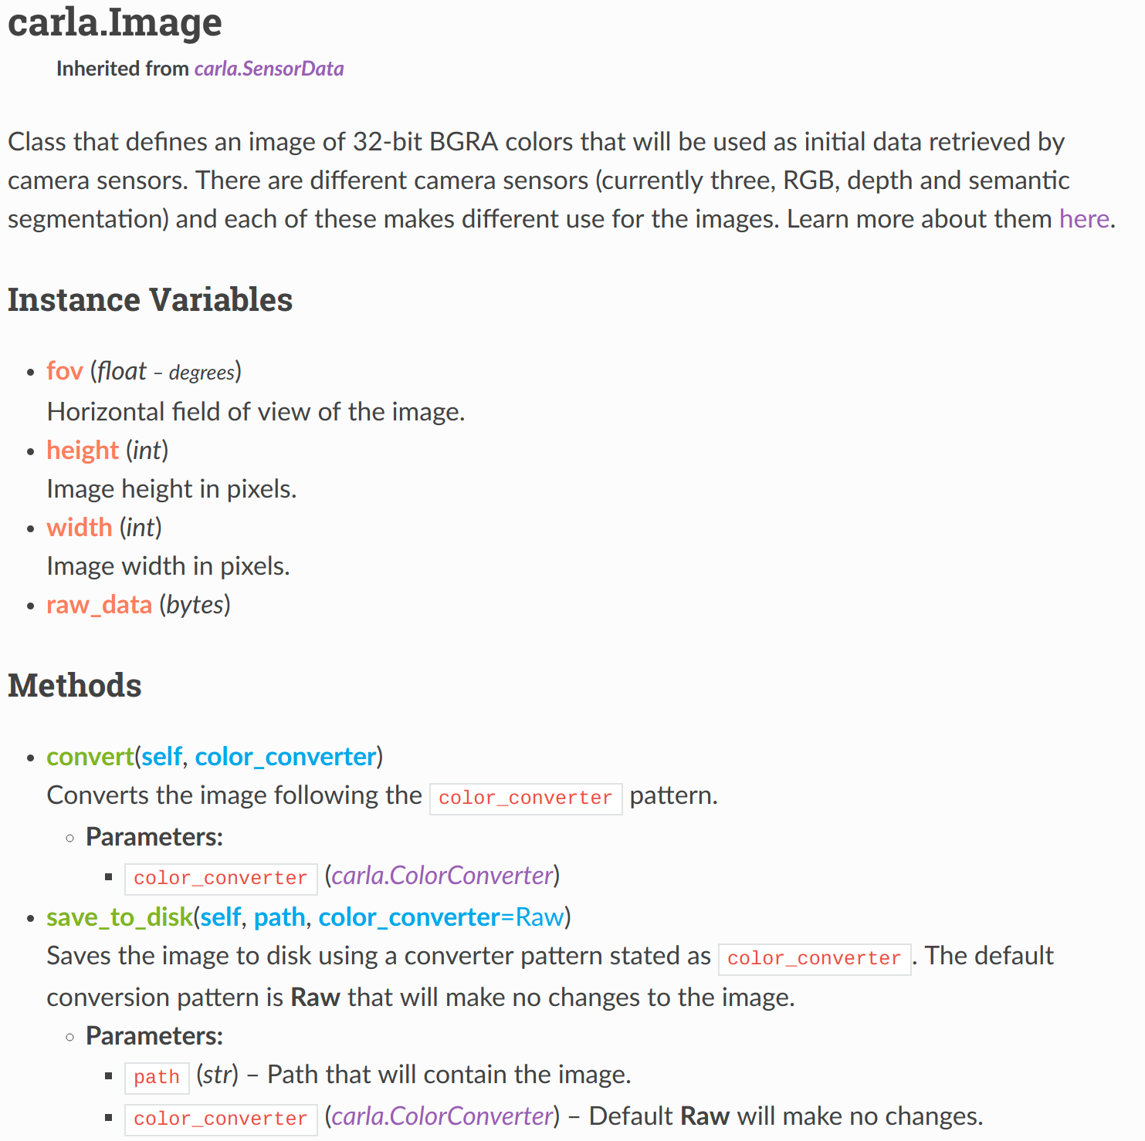
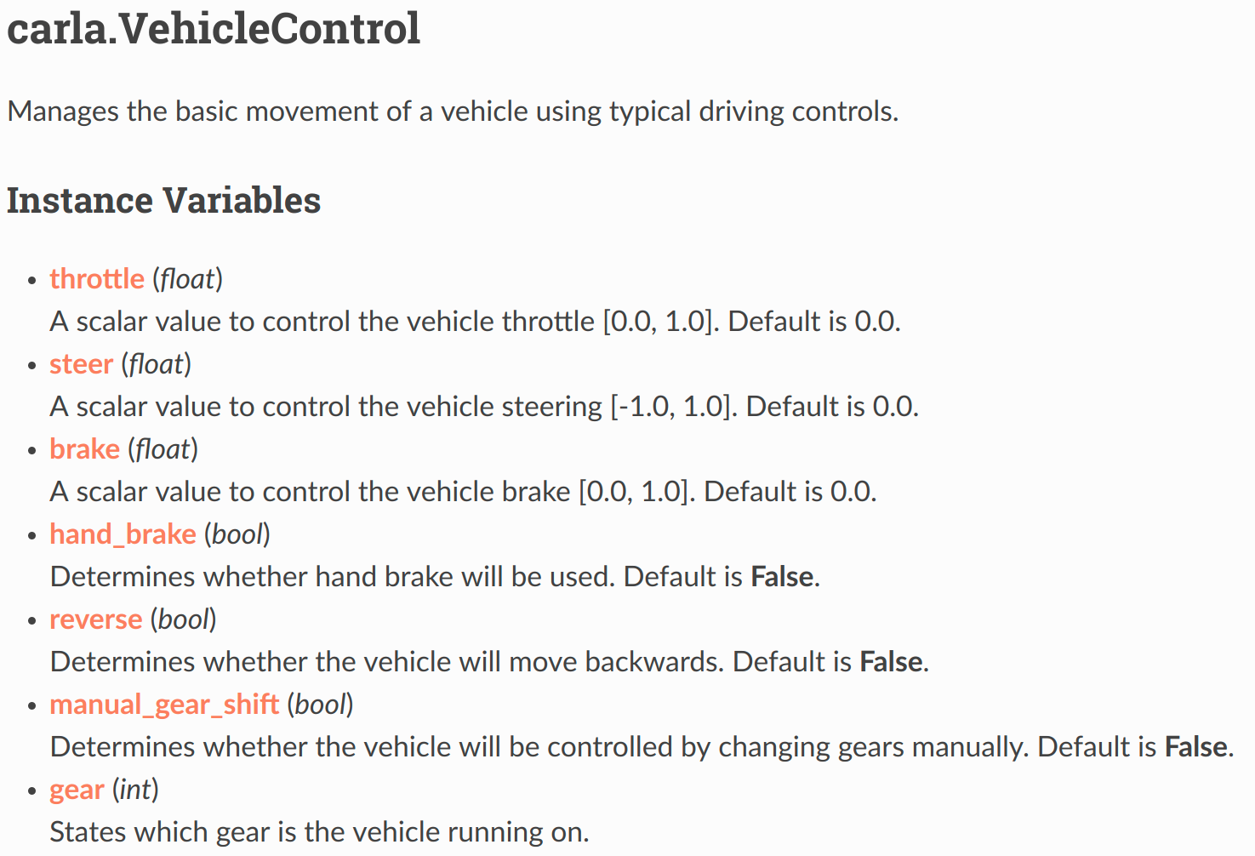
2. Collecting data: Autopilot or manual control
Carla Class
Notes:
涉及到的carla类别，学习如何通过官方手册学习，PythonAPI

Slide 8
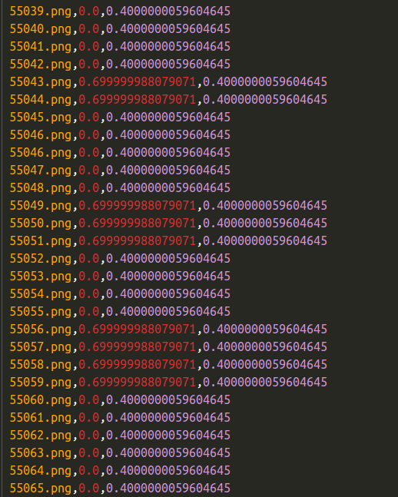
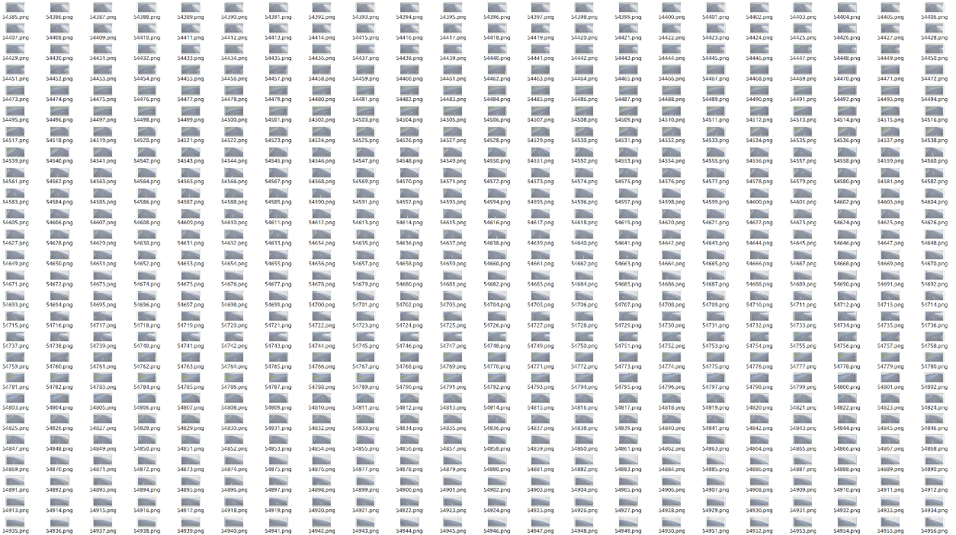
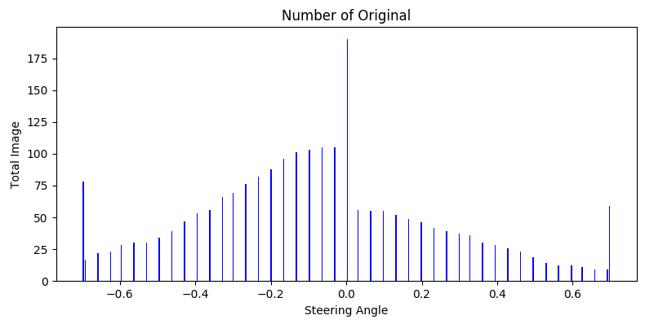
3. Training Model: Supervise learning
Preprocess data：
Vehicle States: y_label
RGB-Image: x_train
Timestamp
Resize;
RGB-image to gray-image;
Crop;
Distribution;
Y_label: steer
Throttle
Notes:
对于数据的处理：让数据的分布尽量合理；
时间戳和车辆状态数据要对应

Slide 9
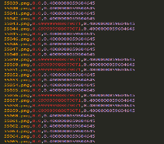
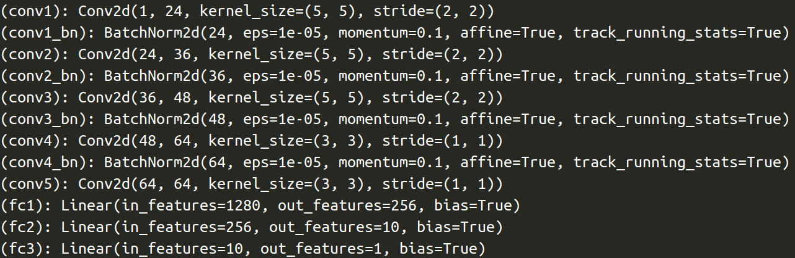
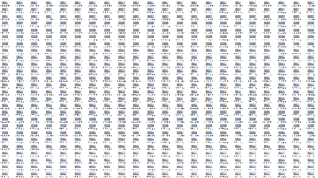
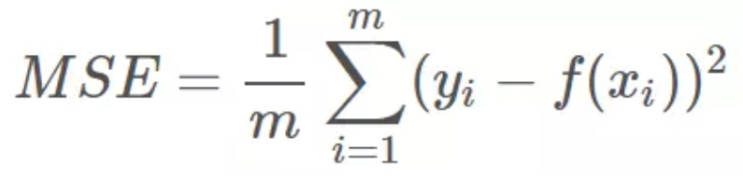
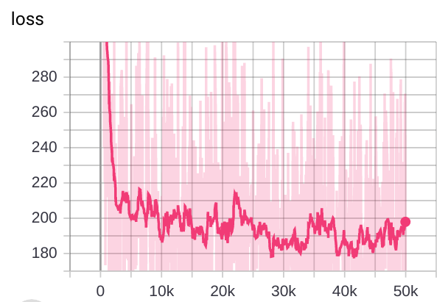
3. Training Model: Supervise learning
Training
Loss function
Model: CNN+BatchNormalization+Fully_connect
X inputs

Slide 10
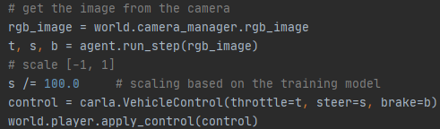
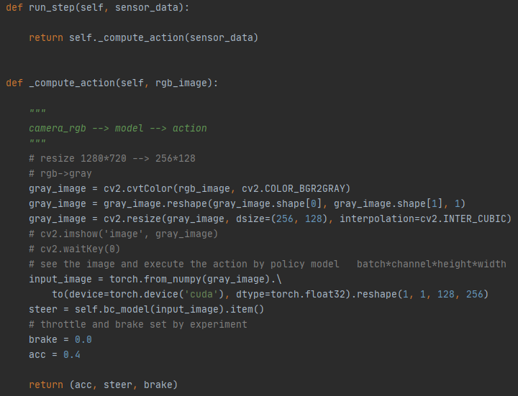
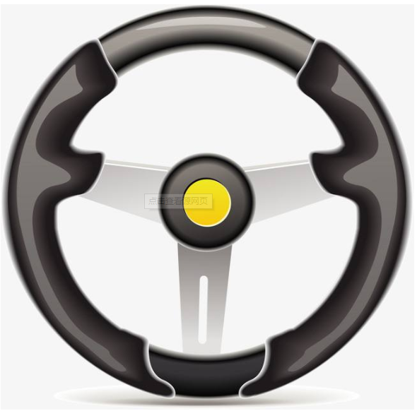
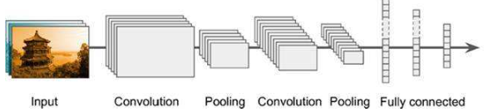
4. Control the vehicle
Demo
Rgb-image
Notes:
展示的过程：sensor看到的场景，给到训练好的模型，模型输出对应的steer，控制车辆。

Slide 11
MoCAD: Carla-python Experimental Course
Behavior cloning (BC)
Testing scenario image does not in the collecting data ;
Velocity is faster or slower ;
How to get the perfect performance ；
Carla over ! But …
Notes:
课程总结与分析，
（1）Data中没有测试数据怎么办呢？
（2）velocity=0.4 fast or slower ?
(3) perfect performance
可以尝试在脚本文件中改进哈

Slide 12
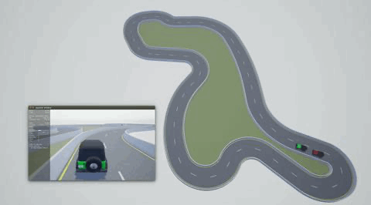
Intermediate project: Leader-follower instance
Control a vehicle: Traditional or learning
Traditional: Keyboard and self-driving PID
Leader-follower instance: keyboard – PID
Tips:
How to get the state information of leader ?
What does the follower follow ?
How to control two vehicles ?
Notes:
简短的介绍一下中期project。
设计的目的是什么：掌握控制方法
难点在哪里：跟随的本质
给出提示。。。

